Slide 1
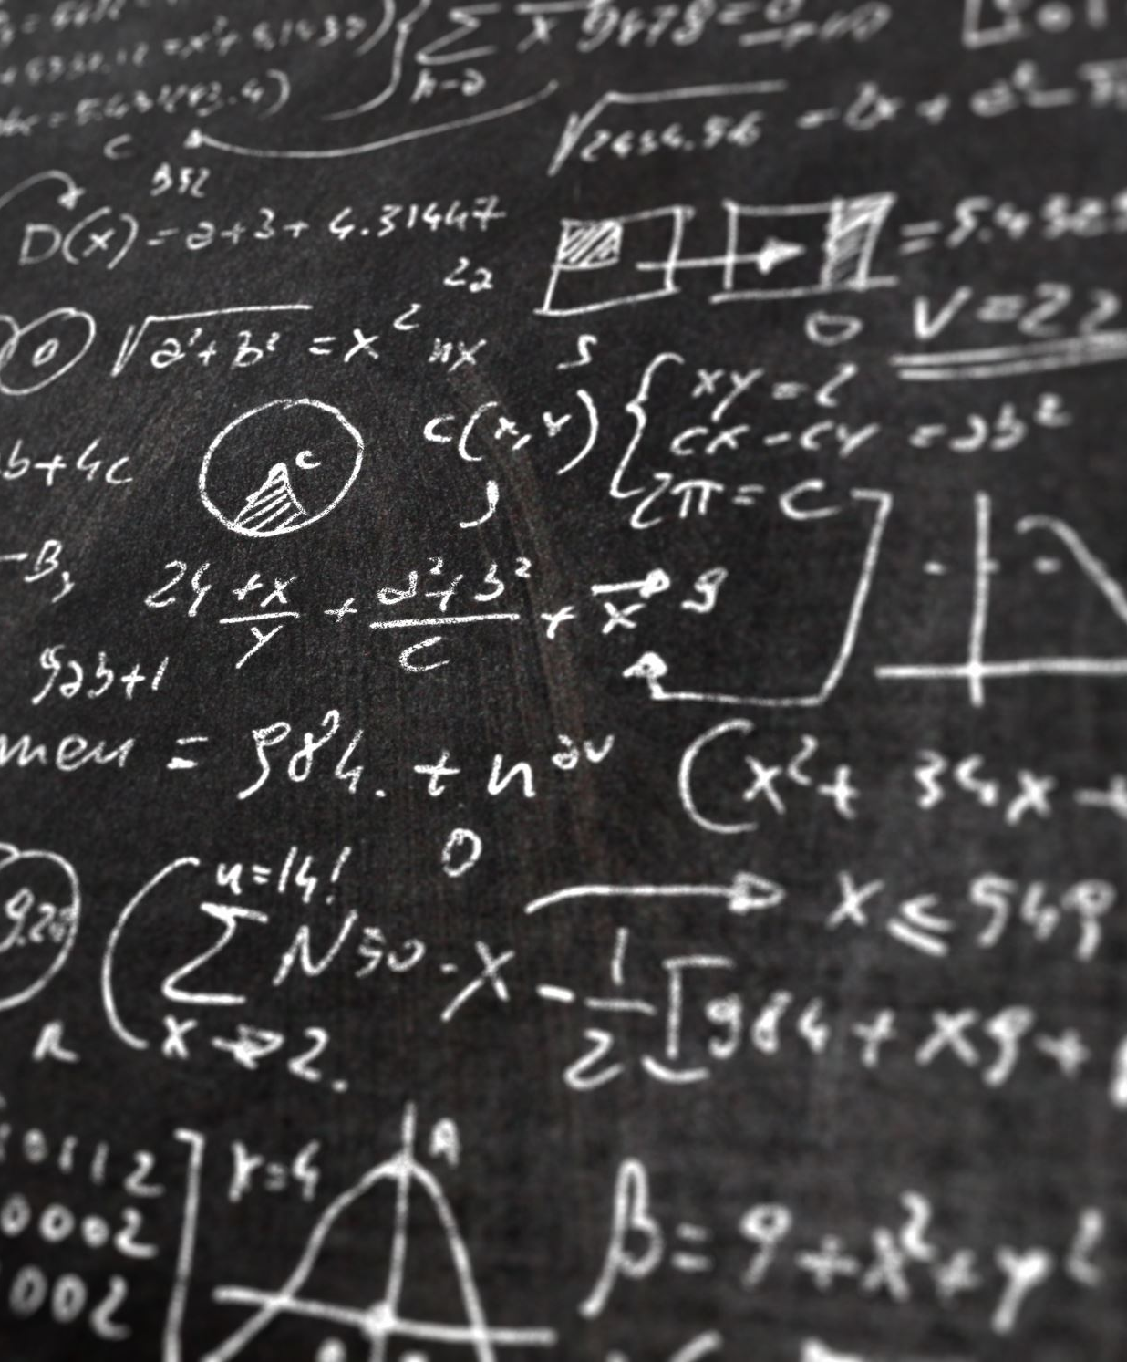
Comparing and Contrasting Clustering in Machine Learning, algorithms DBSCAN and BIRCH.
Tomy Romero
CSC 497
Fall 2022

Slide 2
What is Clustering and unsupervised learning
Clustering depends on unsupervised machine learning.
Unsupervised learning in machine learning are types of algorithms that learns patterns from untagged data.
The idea is to mimic behaviors like people do in real life.
The clustering algorithms are used to process data that is unclassified, raw and takes them into groups that are then represented by structures and patterns that reside in the information.

Slide 3
Abstract
Hypothesis: Which Clustering algorithm performs better using the same dataset, DBSCAN or BIRCH.
How do machine learning algorithms differ from one another?
How do they compare?
What attributes do these algorithms possess and how do they function.
I will talk about this and more by covering a special type of Machine Learning operation called clustering and how the algorithms DBSCAN and BIRCH represent this ideology.

Slide 4
Background
Data mining is a technique found in clustering which takes groups of unlabeled data and bases them on their differences and similarities.
Clustering can be broken down into different categorized types such as probabilistic, overlapping, hierarchical and specifically exclusive.
In this report the types of clustering I will be covering are density clustering with the DBSCAN algorithm and hierarchical clustering with the BIRCH algorithm.

Slide 5
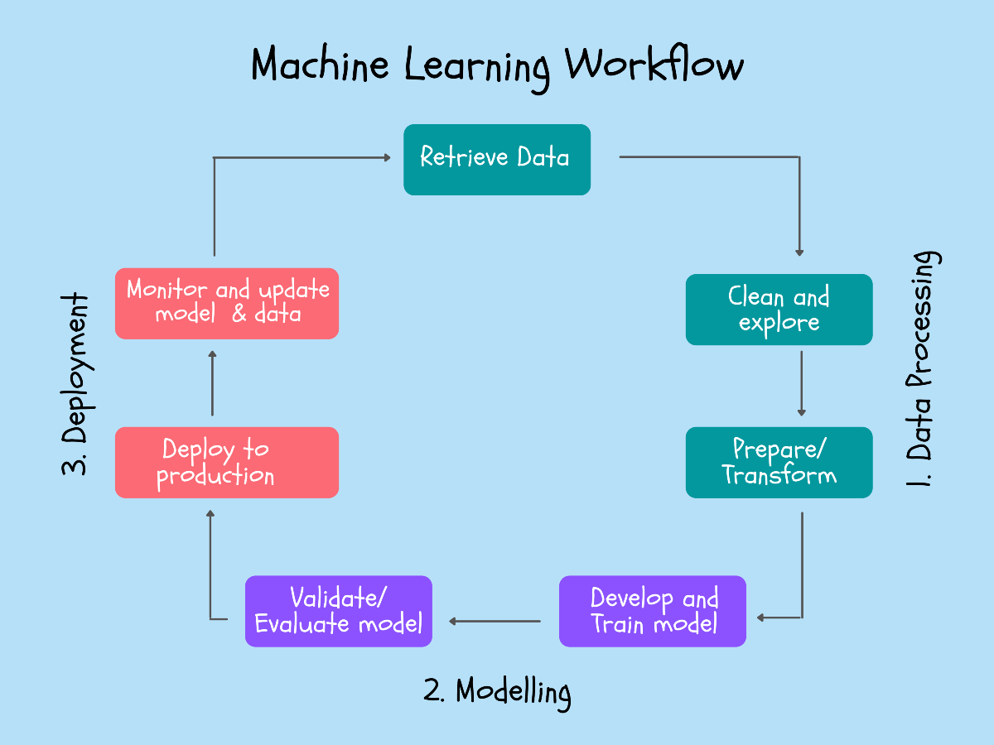
Method and Approach:
The rationale behind the machine learning:
to gather data (https://gist.github.com/pravalliyaram/5c05f43d2351249927b8a3f3cc3e5ecf ) Credit goes to Github Repo for their data.
preprocess the data
decide what model will be best for the data type train and test the data model
elevate the results

Slide 6
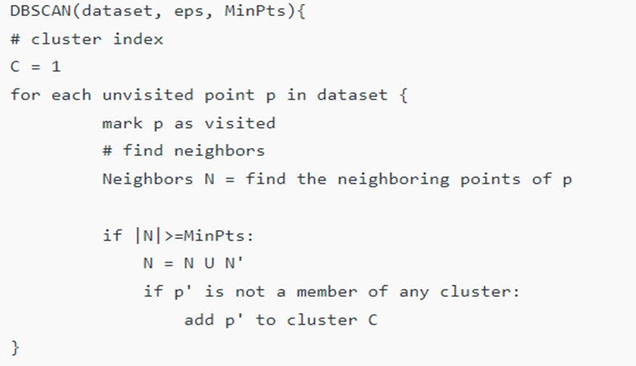
Design and Implementation DBSCAN:
The design and implementation of the DBSCAN algorithm can be described as
•Find all the neighbor points within eps
•identify the core points with more than MinPts neighbors.
•If core not already assigned to a cluster, create a new cluster.
•Find density connected points and assign them to the same cluster as the core point.
•Iterate through the remaining unvisited points in the dataset.

Slide 7
Design and Implementation BIRCH:
Birch converts data into a tree data structure, while the centroids are being read off the leaf.
the centroids can remain the final cluster centroid.
Four Phases:
• Scanning data into memory.
• Resize Data
• Global clustering.
• Refining clusters

Slide 8
Evaluation and interpretation of results:
K-means:
k-means clustering is a simple and well-known unsupervised machine learning algorithm.
Its objective is to group data points together so that it showcases underlying patterns in the data.
To accomplish its goal, the algorithm searches for a fixed number of clusters from a provided dataset. The method must define a target number k, which implies to the number of centroids needed in the dataset.

Slide 9
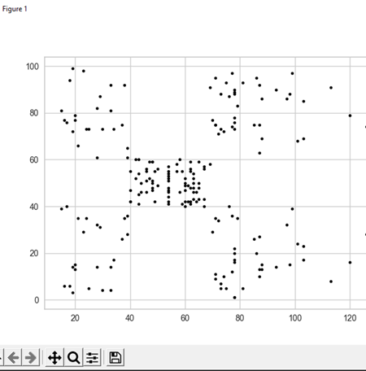
K-means Application:
Data: Sample mall customers spreadsheet
the columns included goes as customer ID, gender, age, annual income, and spending score.
The spending score represents the score provided to a customer by mall authorities, based upon the money spent and the actions of the customer.
I want to use clustering to provide a pattern in the data based on the annual income of and spending score of customers.
First, I visualized the scatter plot of the data using Python and the columns Annual income and Spending Score

Slide 10
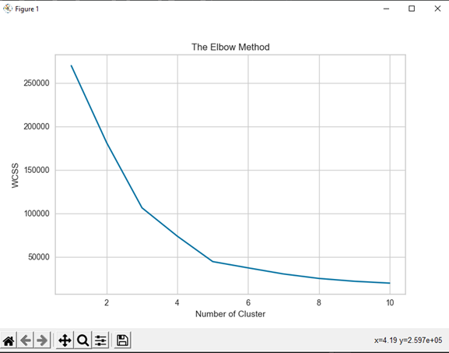
K-means Application The Elbow Method
After accessing the data:
The elbow method performs K-means clustering with the dataset for the range of values, for example 10 iterations, and then proceed to compute the value of k an average score of all the clusters.
WCSS represents the sum of squared distance between each point and the centroid.
The elbow method gets its name because when the data is plotting the WCSS along with the k value look like an Elbow.
When the number of clusters goes up, the WCSS goes down. Therefore, the WCSS value is biggest when K is equal to one.

Slide 11
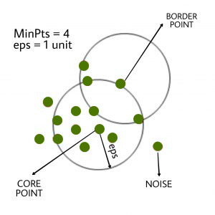
DBSCAN Application
Unlike K-means, in DBSCAN clusters are arbitrary-shaped, which may contain noise or outliers, in contrast to k-means clusters which are spherical shaped.
DBSCAN stands for Density Based Spatial Clustering of Applications with Noise.
Clusters are created from dense areas and apart from little to no density areas.
Apart from K-mean, DBSCAN does not ask for several clusters at first.
DBSCAN needs E and minPts parameters to cluster.
Eps is the neighborhood around a data point, therefore, if the distance between two data points is less than or equal to Eps then they are neighbors.
MinPts are the minimum number of neighbors in the Eps radius.
Data point p are randomly selected data points that are called core points
Border points are data points within e-neighborhood of P and has lower number of minimum points within the place.
a point that is not considered a core or border point is known as a Noise point.

Slide 12
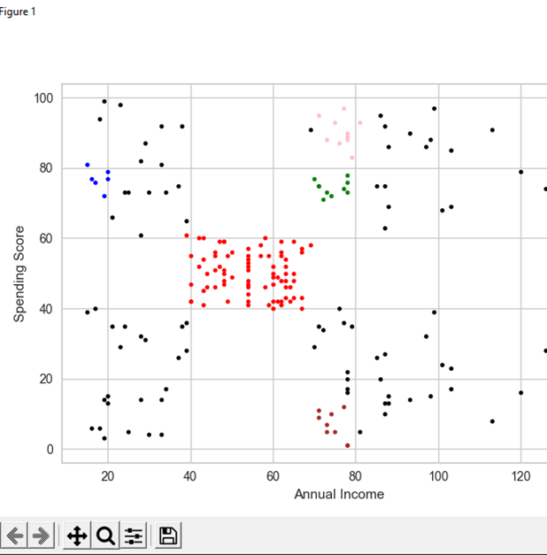
DBSCAN Application:
Same data was prepared for DBSCAN using the same columns of annual income and spending score.
Data was fitted into a model then the same data was predicted to acquire the labels to map the graph.
Using the PLT library we can visualize the results and determine whether the algorithm detected the clusters.
Successful clustering was conducted

Slide 13
BIRCH Application
Regular cluster algorithms don’t scale to running time and quality with large sets.
Balanced Iterative Reducing and Clustering using Hierarchies (BIRCH) is an algorithm that can cluster large datasets.
Generates a compact and small summary of the large dataset it uses to keep as much information as possible.
The algorithm summarizes its large data sets into dense smaller regions which are Clustering Features.
Clustering Features are written as ordered triples (N, LS, SS)
N is the amount of data points in the cluster
LS is the linear sum of data points
SS is what data points’ squared sum.
Clustering Trees (CT) is the compact representation
In a clustering tree there are leaf nodes that each contain a sub-cluster.
In every entry the tree holds a pointer to a child node. A clustering tree entry is made up from the sum of the entries into the child nodes.
Each child node has a maximum number of entries which is referred to as the threshold.

Slide 14
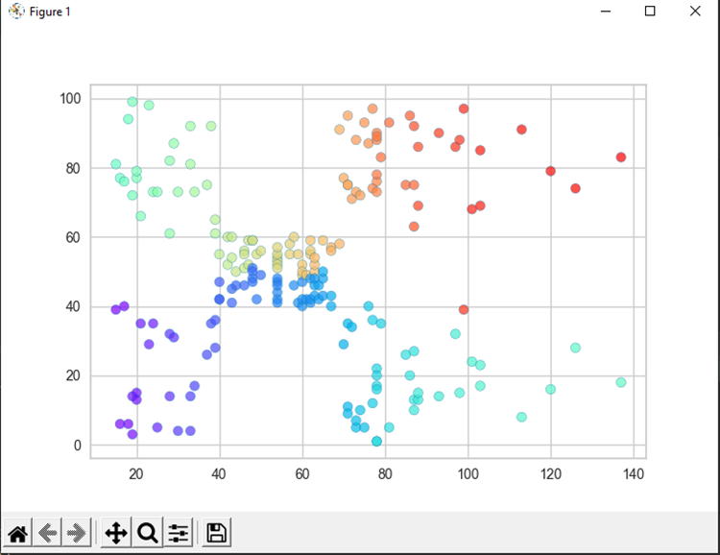
BIRCH Application
•Find a model, in my case I will be using the same Mall Customers Data
•Fit the Data
•Visualize the Results
Implementation of successful clustering

Slide 15
Setting up the Results:
To conduct this experiment on which Algorithm runs the dataset better:
I set time functions in python during the duration of algorithms ten time and calculated the average time to provide the most accurate result.
I also calculated the Silhouette Score for each Algorithm.
The Silhouette Score is a measurement used to analysis the performance of a clustering algorithm.
It uses the compactness of specific clusters also known as the intra cluster distance and the separation within the clusters which is the inter cluster distance.
It takes these attributes to measure the representative overall score and it determines how well the clustering algorithm has operated.
S=(b−a)/max(a,b)S=(b−a)/max(a,b)
A is the intra-cluster distance
B is the mean nearest cluster distance.
The Silhouette Score ranges from -1 to 1.
When the score is closer to one, it shows that its better at clustering

Slide 16
Performance Results:
Round | K-Means | DBSCAN | BIRCH
1 | 1.990 | 1.323 | 1.323
2 | 2.668 | 0.925 | 1.063
3 | 1.830 | 1.394 | 0.323
4 | 1.763 | 1.215 | 1.331
5 | 1.920 | 1.130 | 0.962
6 | 2.016 | 1.320 | 1.189
7 | 1.872 | 1.337 | 1.561
8 | 2.192 | 1.176 | 1.197
9 | 2.591 | 1.235 | 1.222
10 | 2.205 | 1.278 | 1.294
Algorithm | Sum | Median | Average
K-means | 21.047 | 2.003 | 2.1047
DBSCAN | 12.333 | 1.2565 | 1.2333
BIRCH | 11.455 | 1.2095 | 1.1455
DBSCAN Silhouetter Score: 0.114
BIRCH Silhouetter Score: 0.323

Slide 17
Conclusion and Future Work:
The algorithm that performs better using the same dataset is BIRCH.
This claim is supported by two factors, the data of the time/performance.
BIRCH performed faster but it also had more accurate results.
BIRCH got the lowest sum, median and average of the test runs.
BIRCH also had the higher Silhouetter Score.
For Future Work:
Use more datasets that can be ran with both algorithms so that further tests can be ran
Use different metrics to test the efficiency of the algorithms

Slide 18
References:
IBM Cloud Education. (n.d.). What is unsupervised learning? IBM. Retrieved November 20, 2022, from
Self-organizing maps - kohonen maps. GeeksforGeeks. (2022, February 16). Retrieved November 20, 2022, from https://www.geeksforgeeks.org/self-organising-maps-kohonen-maps/
DBSCAN clustering in ML: Density based clustering. GeeksforGeeks. (2022, August 24). Retrieved November 20, 2022, from https://www.geeksforgeeks.org/dbscan-clustering-in-ml-density-based-clustering/
Siddiquiamir. (2022, January 15). Python-clustering-tutorials/mall_customers.CSV at main · Siddiquiamir/python-clustering-tutorials. GitHub. Retrieved November 30, 2022, from https://github.com/siddiquiamir/Python-Clustering-Tutorials/blob/main/Mall_customers.csv
Google. (n.d.). What is clustering? &nbsp2;|&nbsp; machine learning &nbsp;|&nbsp; google developers. Google. Retrieved November 20, 2022, from https://developers.google.com/machine-learning/clustering/overview#:~:text=In%20machine%20learning%20too%2C%20we,relies%20on%20unsupervised%20machine%20learning.
Workflow of a machine learning project - towards data science. (n.d.). Retrieved November 20, 2022, from https://towardsdatascience.com/workflow-of-a-machine-learning-project-ec1dba419b94
Birch in Data Mining - Javatpoint. www.javatpoint.com. (n.d.). Retrieved November 20, 2022, from https://www.javatpoint.com/birch-in-data-mining
How DBSCAN works and why should we use it? (n.d.). Retrieved November 20, 2022, from https://towardsdatascience.com/how-dbscan-works-and-why-should-i-use-it-443b4a191c80
Benzer, N. J. (2022, May 25). Balanced iterative reducing and clustering using heirarchies(birch). Medium. Retrieved November 20, 2022, from https://medium.com/@noel.cs21/balanced-iterative-reducing-and-clustering-using-heirachies-birch-5680adffaa58
Bedre, R. (2022, May 1). DBSCAN in python (with example dataset). Data science blog. Retrieved November 29, 2022, from https://www.reneshbedre.com/blog/dbscan-python.html
Kumar, A. (2021, June 21). Kmeans silhouette score with python examples - dzone. dzone.com. Retrieved November 30, 2022, from https://dzone.com/articles/kmeans-silhouette-score-explained-with-python-exam
Thevapalan, A. (2022, May 16). The Machine Learning Workflow explained (and how you can practice it now). Medium. Retrieved November 30, 2022, from https://towardsdatascience.com/the-machine-learning-workflow-explained-557abf882079

